Slide 1
Player Detection and Team classification
Thodoris Goulas

Slide 2
Motivation
1

Slide 3
Object Detection
Real-time object detection
Target classes:
player
referee
ball

Slide 4
Team Classification
Separate players based on team
Target classes:
Lakers (white jerseys)
Raptors (red jerseys)

Slide 5
Related Work
2

Slide 6
Mason Liu et al.
object detection in video streams
utilize memory to improve accuracy and computational time
Shaoqing Ren et al.
generate high-quality region
RPN and Fast R-CNN combined
Kaiming He et al.
added a Mask-RCNN to Faster R-CNN model
object detection & a high-quality segmentation mask simultaneusly
Mingxing Tan et al.
proposed EfficientDet network
utilize a weighted bi-directional feature pyramid network (BiFPN)
Bochkovskiy et al.
developed Darknet framework
proposed YOLOv4 network

Slide 7
Data Preparation
3

Slide 8
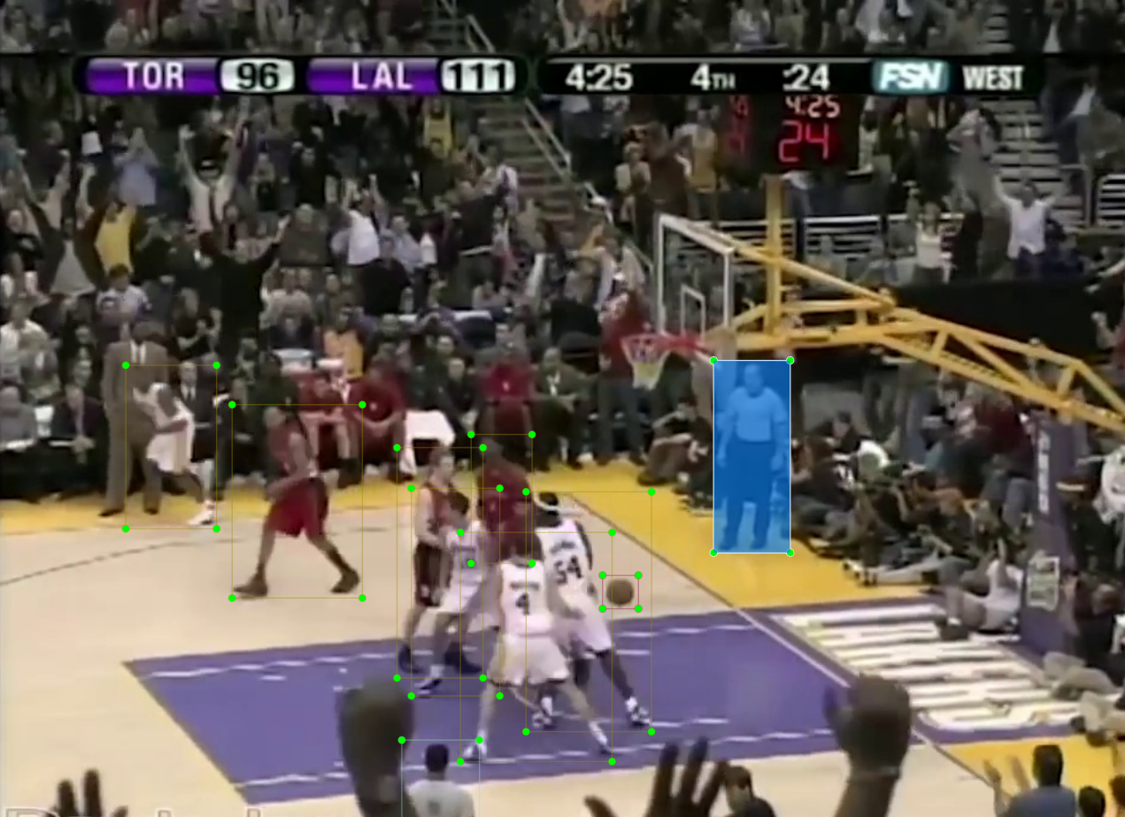
Dataset
frames extracted from NBA game broadcast
LabelImg tool used to manually annotate images
140 frames collected and annotated
imbalanced dataset

Slide 9
Object Detection
4

Slide 10
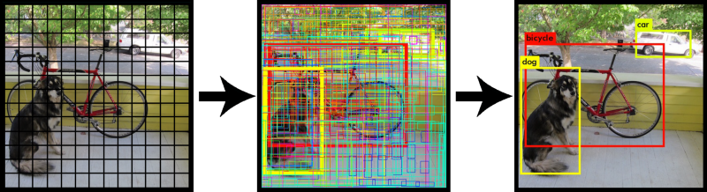
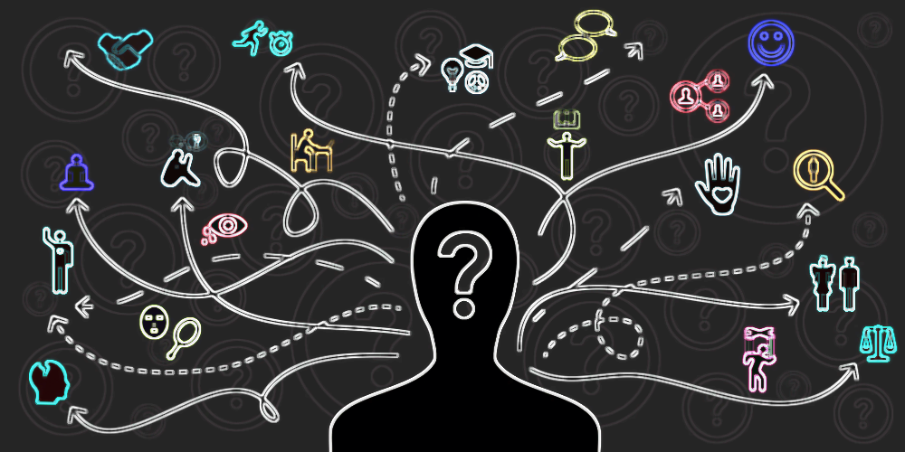
YOLOv4 (1/5)
developed on Darknet framework
GPU and CPU support
regression -> identify object (bounding boxes)
classification -> determine object class

Slide 11
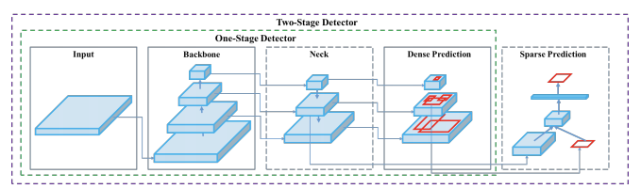
YOLOv4 (2/5)
One-stage detector
Backbone: CNN for feature extraction
Neck: Combination of features extracted per layer
Dense Prediction (Head): object localization & classification

Slide 12
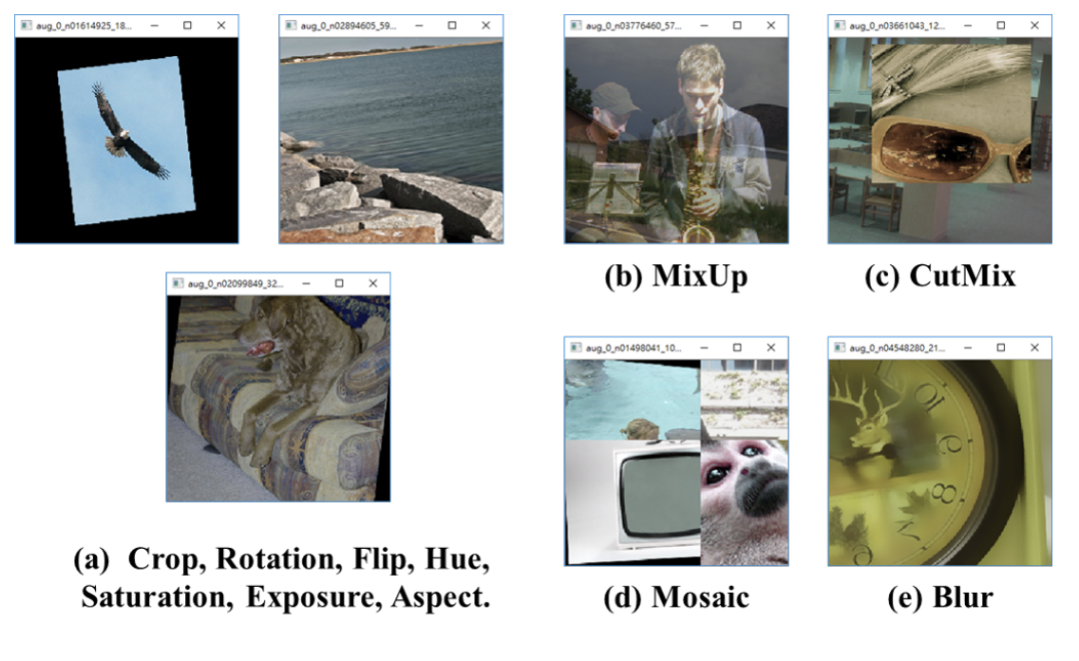
YOLOv4 (3/5)
“Bag of Freebies” -> Data Augmentation techniques

Slide 13
YOLOv4 (4/5)
“Bag of Specials”:
Mish activation function
DIoU NMS technique (optimal bounding box)
Cross mini-Batch Normalization (CmBN) (cross-platform)
DropBlock regularization

Slide 14
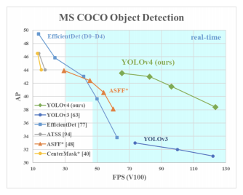
YOLOv4 (5/5)

Slide 15
Team Classification
5

Slide 16
Team classification
players’ jersey color as criterion
OpenCV framework
Frames migrated from RGB to HSV
Color masks were applied to “player” boxes
Decision was made based on colored pixels precentage

Slide 17
Model Training
6

Slide 18
Training process
Batch size: 64 (3 channels, 16 subdivisions)
Epochs: 6000
Learning rate: 0.001
Confidence level: 0.33

Slide 19
Results
7

Slide 20
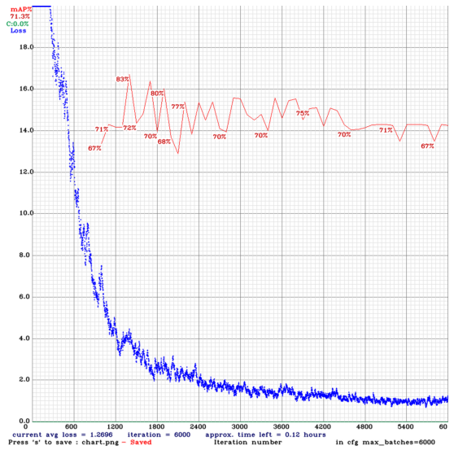
Learning Curve

Slide 21
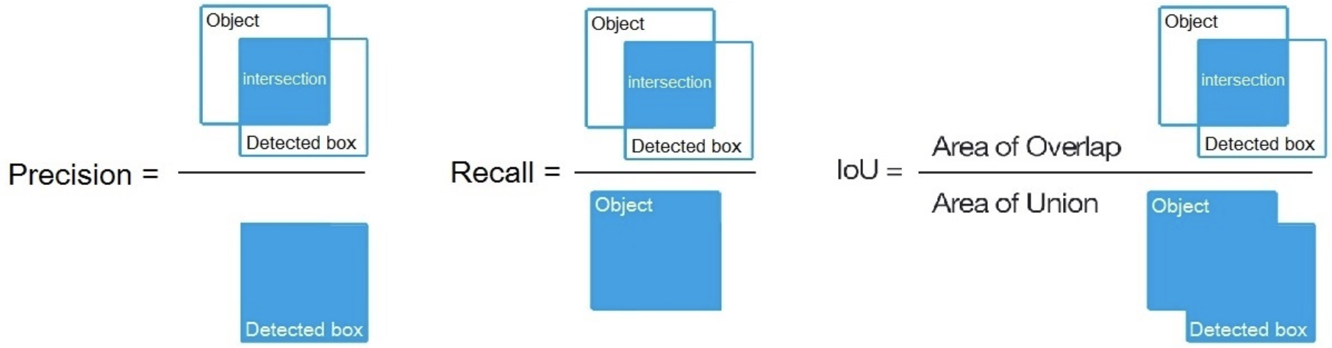
Accuracy Metrics
Precision = 0.97
Recall = 0.91
Average IoU = 77.61%
MAP = 83.49%
Classes | TP | FP | Precision(%)
player | 60 | 1 | 95.24
referee | 14 | 1 | 95.24
ball | 1 | 0 | 60.00

Slide 22
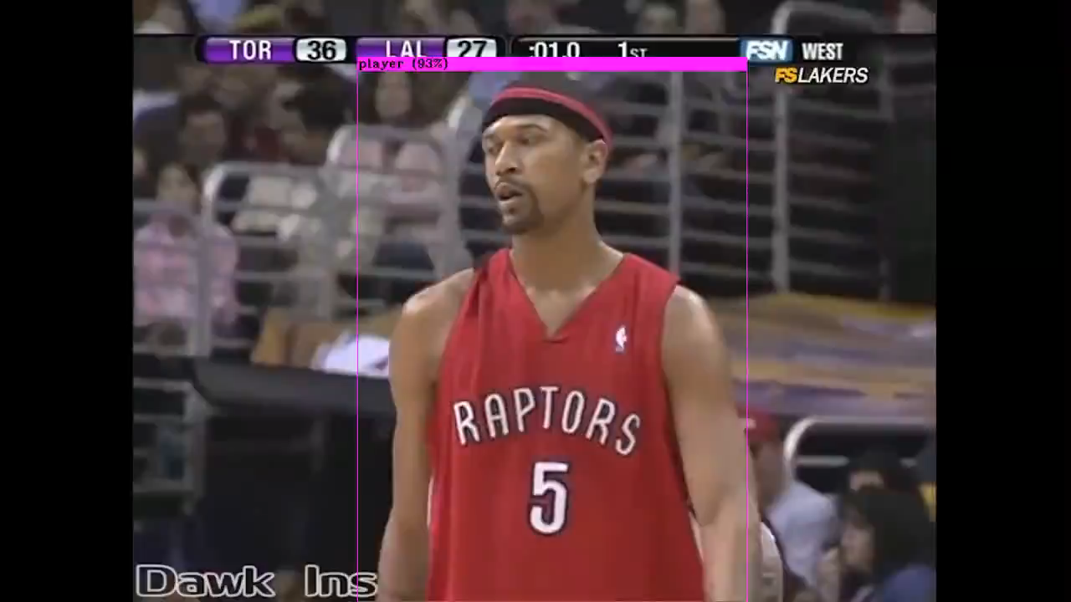
Real-time object detection

Slide 23
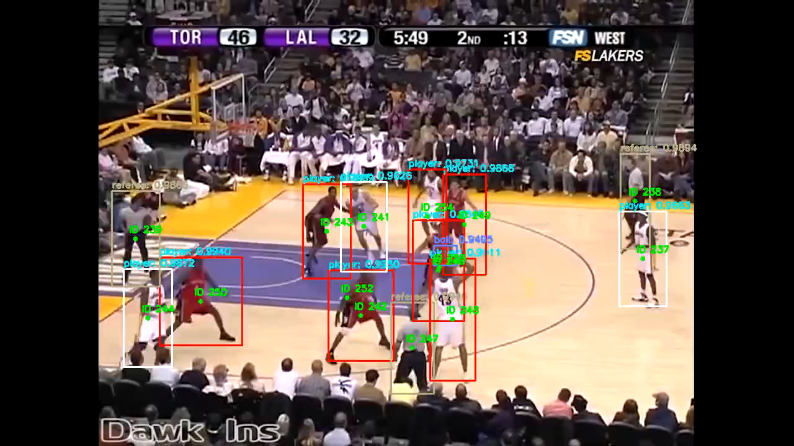
Real-time team classification

Slide 24
Conclusion
7

Slide 25
Object Detection – Team Classification
Decent results
Cannot be generalized (small dataset)

Slide 26
Future Work
Expand Dataset
Further experiments - tuning on color masks
Team classification as unsupervised classification task

Slide 27
THANKS!
Any questions?

